Slide 1

Beyond the limits of CBS RA
Efficient programming and the ODISSEI Secure Supercomputer
Erik-Jan van Kesteren

Slide 2
Before we start…
About me
Assistant professor at Methodology & Statistics, Utrecht University
Team lead for the ODISSEI Social Data Science (SoDa) team advancing data- & computation-intensive research in social science
Strong advocate for open science
About today
We will not solve all your computation problems in less than an hour ☺
I will show R code, but the principles hold for other environments too
If you work at an ODISSEI member organisation: you can get help from the ODISSEI Social Data Science team!

Slide 3


Today
The CBS RA technical
The trinity of trouble
Storage
Memory
Compute
Tips & question time!

Slide 4
The CBS RA: technical

Slide 5

CBS RA technical
The CBS RA server
One big physical computer
Virtual machines: you log in via Citrix and a “windows computer” is instantiated for you
4 virtual CPUs, 48Gb RAM & 100Gb storage
Heavy option: 128Gb RAM
Resources are limited and (FOR NOW) shared across users
Disk access is shared
Memory is shared
Computation is shared
top secret

Slide 6
Top tip #1
Run your heavy tasks during low-intensity hours on the RA environment

Slide 7
Tackling the trinity of trouble

Slide 8



storage
memory
compute
Hard Disk by Creative Stall from NounProject.com
CPU by Liberus from NounProject.com
CPU by DinosoftLab from NounProject.com

Slide 9




loading
importing
processing
saving
storing

Slide 10
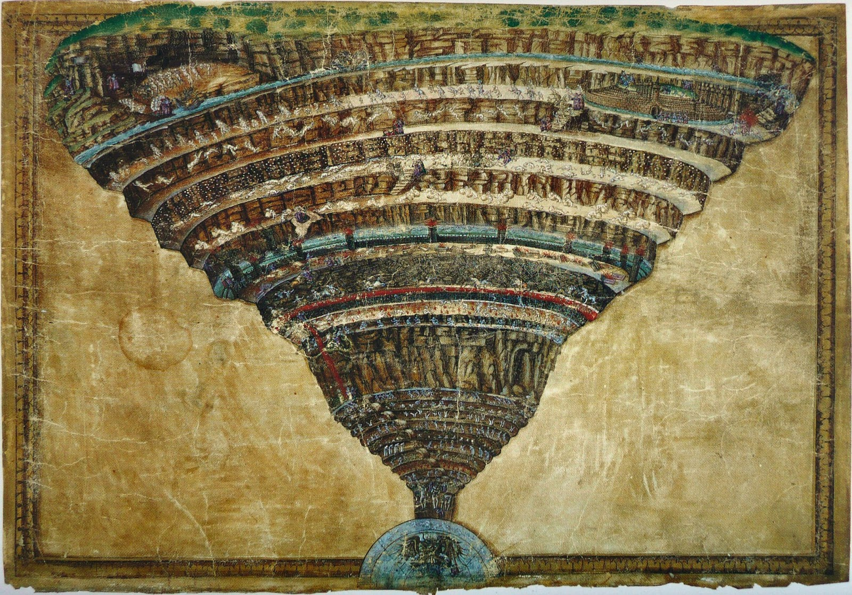
storage
memory
compute

Slide 11
data do not fit on disk
cannot allocate vector of size 223.1 Gb
?? Omg this will take forever!

Slide 12

Storage

Slide 13
Geachte relatie,
Uit een meting op maandag 4 april 2022 blijkt dat project 0000, Titel van het project, een ruimtebeslag kent van 133 GB. De limiet voor het project is 100 GB.
Als u de extra capaciteit daadwerkelijk nodig heeft, dan kunt u een verzoek indienen om extra capaciteit bij te kopen. De kosten hiervoor bedragen 25 euro per 50 GB per maand.
Met vriendelijke groet,
Firstname Lastname
DBD Team Dataservices
CBS | Henri Faasdreef 312 | Postbus 24500 | 2490 HA Den Haag
Email: microdata@cbs.nl
Volg statistiekcbs op twitter | facebook | instagram

Slide 14
Top tip #2
If you can afford it, just buy extra storage space for your project ☺

Slide 15
Efficient project folder structure
my_project/
├─ raw_data/
│ ├─ questionnaire_data.csv
├─ processed_data/
│ ├─ questionnaire_processed.rds
│ ├─ analysis_object.rds
├─ img/
│ ├─ plot.png
├─ 01_load_and_process_data.R
├─ 02_create_visualisations.R
├─ 03_main_analysis.R
├─ 04_output_results.R
├─ my_project.Rproj
├─ readme.md

Slide 16
Efficient project folder structure
my_project/
├─ raw_data/
│ ├─ questionnaire_data.csv
├─ processed_data/
│ ├─ questionnaire_processed.rds
│ ├─ analysis_object.rds
├─ img/
│ ├─ plot.png
├─ 01_load_and_process_data.R
├─ 02_create_visualisations.R
├─ 03_main_analysis.R
├─ 04_output_results.R
├─ my_project.Rproj
├─ readme.md
At CBS, this is on a different disk!
Does not count towards your 100GB quote
Make these objects efficiently stored
Depends on your application

Slide 17
Top tip #3 (small open science digression)
Create a clear code folder, export your code from the RA, and publish it!

Slide 18
Efficiently storing large R datasets
Live coding 1

Slide 19

Memory

Slide 20
Top tip #4
Read your program’s error messages! They give a lot of diagnostic info

Slide 21
In R:
Error: cannot allocate vector of size 745.1 Gb
In Python (numpy)
numpy.core._exceptions._ArrayMemoryError: Unable to allocate 745. GiB for an array with shape (100000000000,) and data type float64
In Stata
(no clue, I really don’t use Stata??)

Slide 22
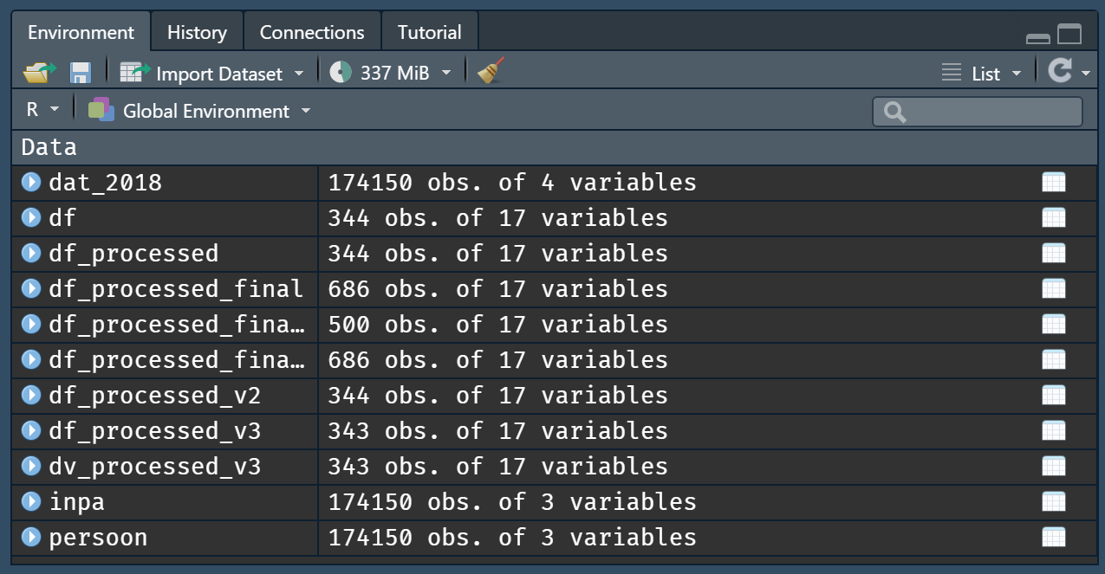
Clean your session / environment

Slide 23
Efficiently processing large datasets
Live coding 2

Slide 24
Larger-than-memory data
Sometimes, your data really is larger-than-memory
It is possible to do analyses on datasets which are on-disk
Two options:
Create chunked data objects
Create a proper database

Slide 25
Top tip #5
Investigate whether the “heavy” RA machine will solve your memory issues

Slide 26
Visualisation & regression with larger-than-memory data
Live coding 3

Slide 27

Compute

Slide 28
Compute-heavy applications
Large simulations, e.g.,
agent-based models
computational models
complex systems stuff
statistical simulations (large power analyses)
Many different conditions
Perform some computation for each neighbourhood in NL
Bayesian estimation with large models (many parameters, many posterior samples)

Slide 29
Speeding up a function with C++
Live coding 4

Slide 30
Embarrassingly parallel
Many independent computations, little or no effort is needed to separate the problem into a number of parallel tasks
Simulations
Applying a function to many conditions
Running a piece of code with many different settings
Bootstrapping

Slide 31
Top tip #6
Is your problem parallelizable? Look into the ODISSEI Secure Supercomputer

Slide 32
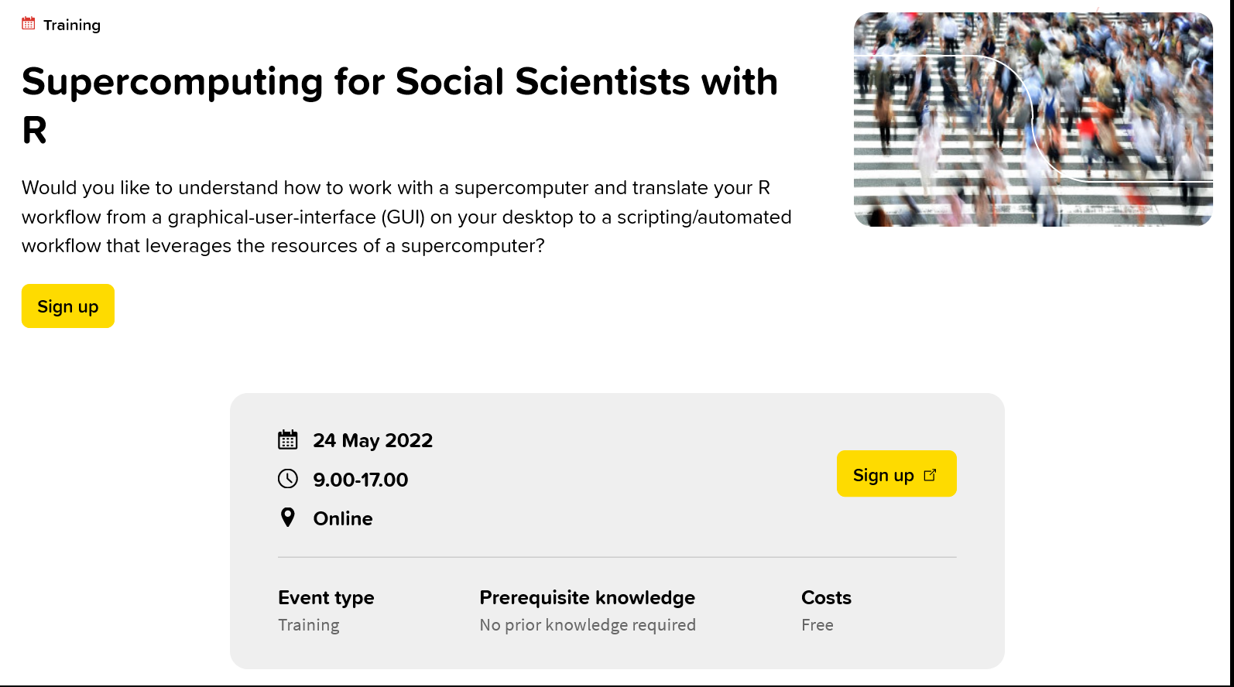

Slide 33
Top tips, collected
Run your heavy tasks during low-intensity hours on the RA environment
If you can afford it, just buy extra storage space for your project ☺
Create a clear code folder, export your code from the RA, and publish it!
Read your program’s error messages! They give a lot of diagnostic info
Investigate whether the “heavy” RA machine will solve your memory issues
Is your problem parallelizable? Look into the ODISSEI Secure Supercomputer
Want to know more? Join the workshop.

Slide 34
Thank you!
https://www.surf.nl/en/agenda/supercomputing-for-social-scientists-with-r
https://github.com/sodascience/cbs_microdata_computing

Slide 35
Questions?

Slide 36
Default light slide
Default subheading
This is the body of the text
Default subheading
Note that the text is not black, but “black, text 1, lighter 25%”
Default subheading
This makes things easier on the eyes
Default subheading
This is the body of the text

Slide 37
Default dark slide
Default subheading
The dark slide brings some variation
Default subheading
It can highlight important aspects of the presentation.
Default subheading
This is the body of the text
Default subheading
This is the body of the text

Slide 38
Is this an impact slide?

Slide 39
Here is an impactful slide with a sentence on it.
Here is a topic related to the aforementioned question.

